Slide 1


SPRINT 2
Programmed a simple MQTT Publisher and Subscriber scripts in Python
Analysis the network scenario with Wireshark using Tshark (Lightweight wireshark tool) and PSCP command in command prompt
Discovery of Birth, Keep alive, Lastwill features& Connection Refusal of Unauthorized Broker access in Wireshark
Note: Broker & Subscriber should be in different Rpi’s to see the Lastwill message in wireshark (Same IP problem)
Created the Node-Red Subscriber with Birth, KA & LW features
Built an IP tables Firewall with WiFi Access Point rule set (Now the Ports 80, 22, 443 & 8 are accepted in Chain Input policy, we will also accept the VNC port 5901)
Eg. Accept command: “-A INPUT -i eth0 -p tcp dport 80 -j ACCEPT”
Saved Iptable-rules for booting using iptables-persistent tool (Auto-enable)

Slide 2
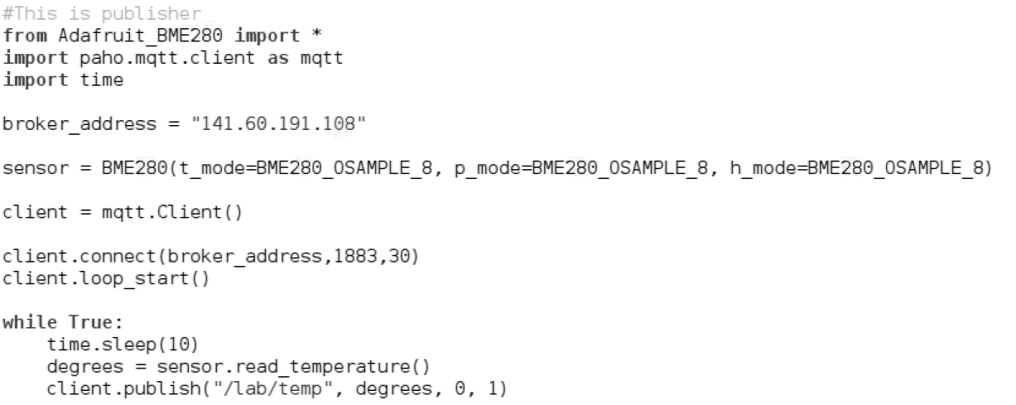
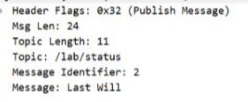

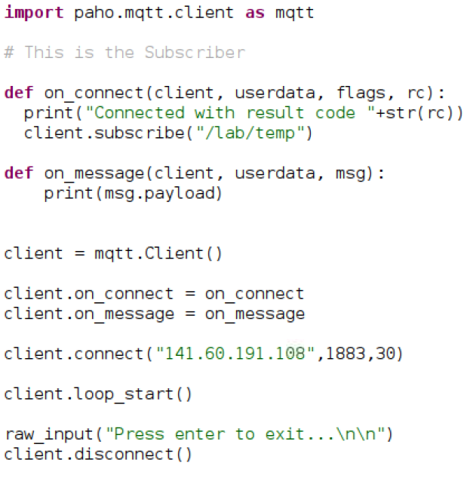
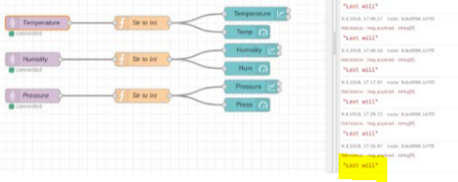

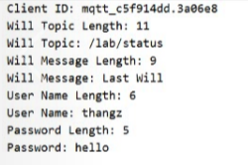
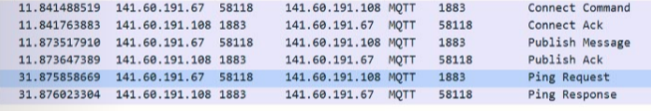
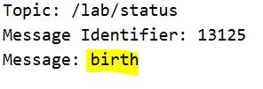
SPRINT 2

